Slide 1
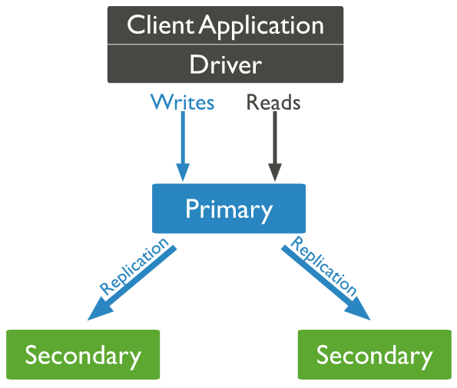

How Setup Multi Nodes Replica Set in MongoDB?
MongoDB achieves replication by the use of replica set. A replica set is a group of mongod instances that host the same data set. In a replica, one node is primary node that receives all write operations. All other instances, such as secondaries, apply operations from the primary so that they have the same data set. Replica set can have only one primary node.
Localhost:27017
Oplog
Single Node ReplicaSet
3 Nodes ReplicaSet
Primary
Primary
Secondary1
Secondary2
Localhost:27018
Localhost:27019

Slide 2
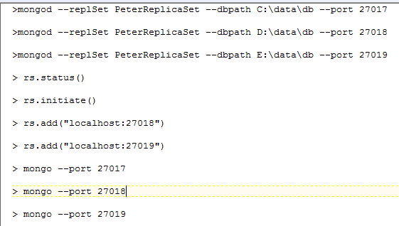
How Setup Multi Nodes Replica Set in MongoDB?

